Slide 1
“The format of a Screenplay”
The Blueprint of a Film

Slide 2
What is a Screenplay?
A blueprint for a film, TV show, or short film
Contains dialogue, actions, and scene directions
Guides directors, actors, and crew
Written in a specific format to ensure clarity

Slide 3
Golden Rules of Screenplay Format
Show, don’t tell
Keep descriptions short and visual
Avoid directing — focus on the story
Follow formatting standards to stay professional
Standard Screenplay Format
Written in Courier 12-point font
One page ≈ one minute of screen time
Average length: 90–120 pages
Uses specific margins and spacing

Slide 4
Key Elements of a Screenplay
•Scene Heading (Slugline) – Location & time (INT. OFFICE – DAY)
•Action – Describes what happens on screen
•Character Name – Centered, in uppercase
•Dialogue – Lines spoken by the character
•Parentheticals – Short directions for delivery
•Transitions – (CUT TO:, FADE IN:)

Slide 5
1 INT. CREDENCE GLOBAL SOLUTIONS – FIFTH FLOOR – PRIME MEETING ROOM – NIGHT
The clock reads 9:28 P.M.
The ARTIVA PROGRAMMING TEAM files into the PRIME meeting room.
Manager PRADEEP leads the group — junior software engineers, software engineers, and DAG team members in tow.
PRADEEP
(to Santosh, polite)
We have this room booked from 9:30 to 10:30 for Artiva training.
CUT TO:
Scene Heading
Action
Character Name
Parenthesis
Dialogue
Transition

Slide 6
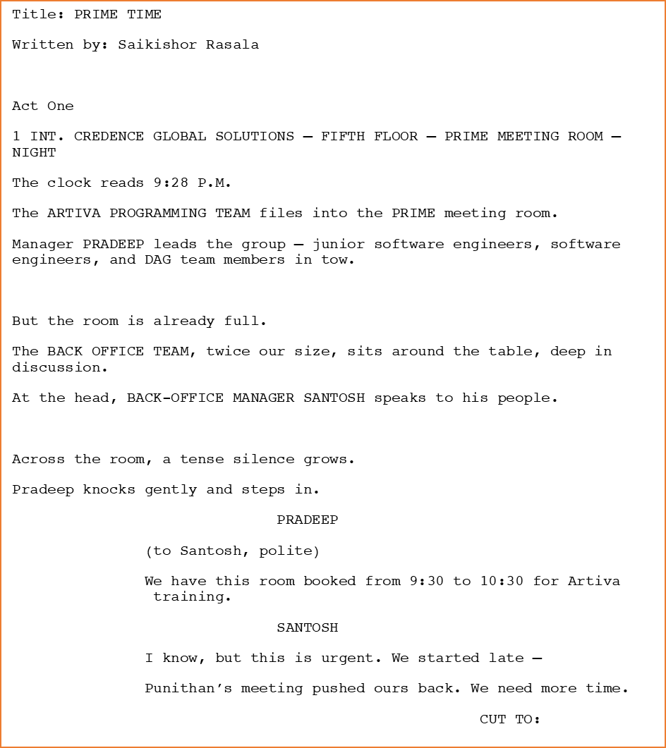
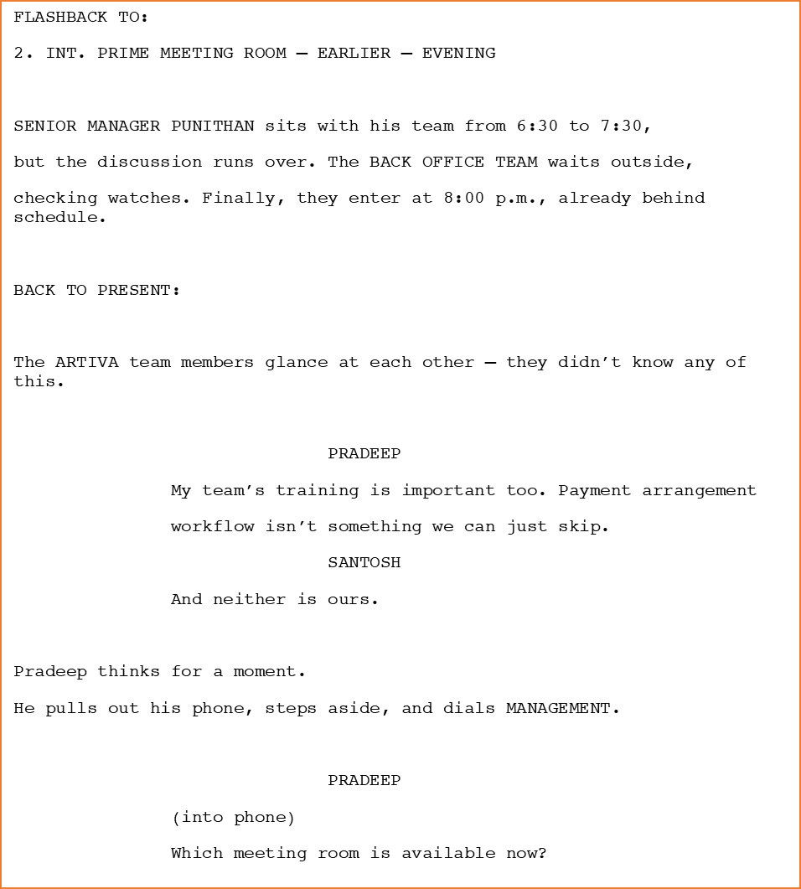

Slide 7
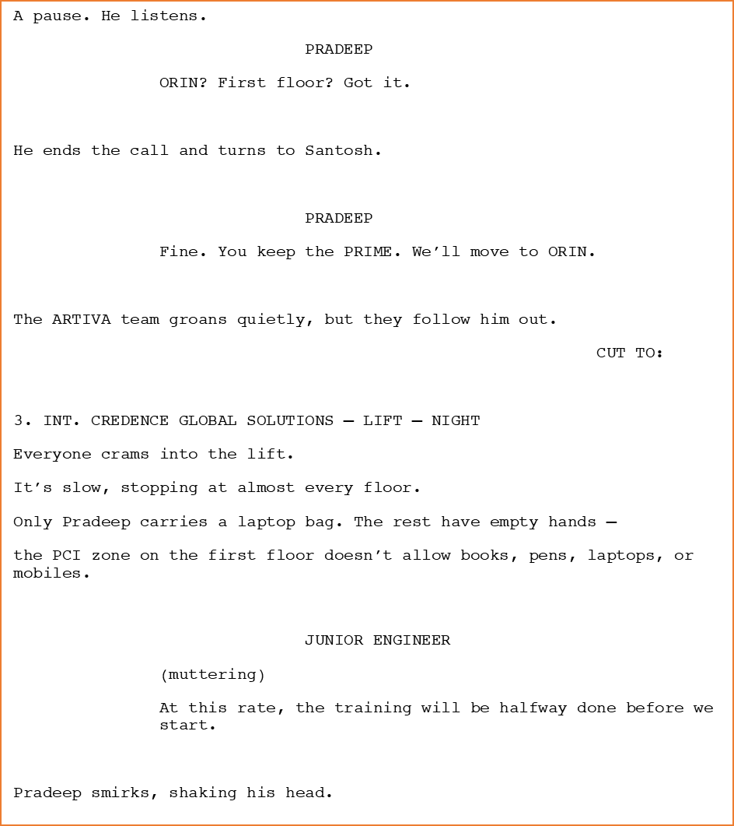
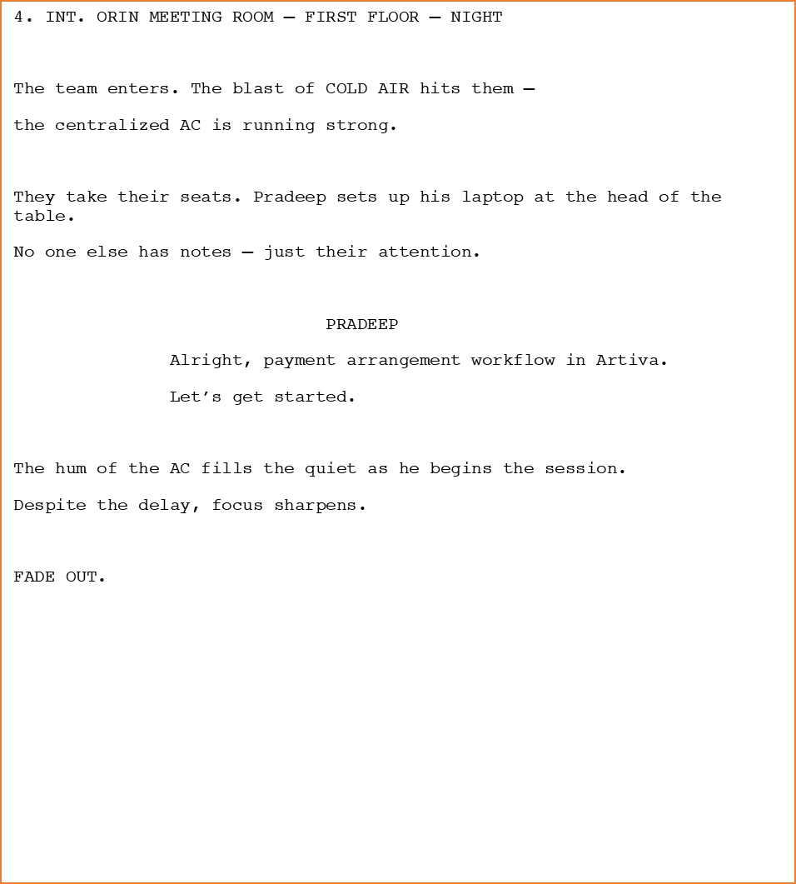

Slide 8
Written By
Saikishor Rasala

